Slide 1
PROGRESS IN THE ESTABLISHMENT OF CMAS 3rd National Steering Committee for the establishment of CMAS in SA 31 MAY 2013

Slide 2
CORE BUSINESS
TOP TEN RISKS
PROGRESS AND KEY TIMELINES
19 March 2012 | Minister approved the establishment of nine CMAs in nine WMAs
21 May 2012 | Gazetting of WMAs for public consultation approved.
June 2012 | National Steering Committee established to oversee implementation (DWA, National Treasury, SALGA,CMAs, Civil Society.)
20 July 2012 | Gazette published (No 35517 ) on proposed WMA.
31 March 2013 | Business Cases and Proposals for Inkomati - Usuthu and Breede Gouritz CMAs approved by Minister for gazetting establishment notices for comment.

Slide 3
PROGRESS AND KEY TIMELINES
June 2013 | Business Cases for Limpopo and Pongola Umzimkhulu, developed and prepared for Minister’s signature for gazetting notices for comment for 60 days.
August 2013 | Gazette notices for the establishment of Inkomati Usuthu and Breede Overberg CMAS published.
September 2013 | Finalise the new process on appointing of the Board. Board appointments for Inkomati-Usuthu Limpopo, Umzimkhulu, and Breede-Gouritz CMAS will commence
March 2014 | Business plans submitted to Minister from Inkomati-Usuthu and Breede-Gouritz CMAS
CORE BUSINESS
TOP TEN RISKS

Slide 4
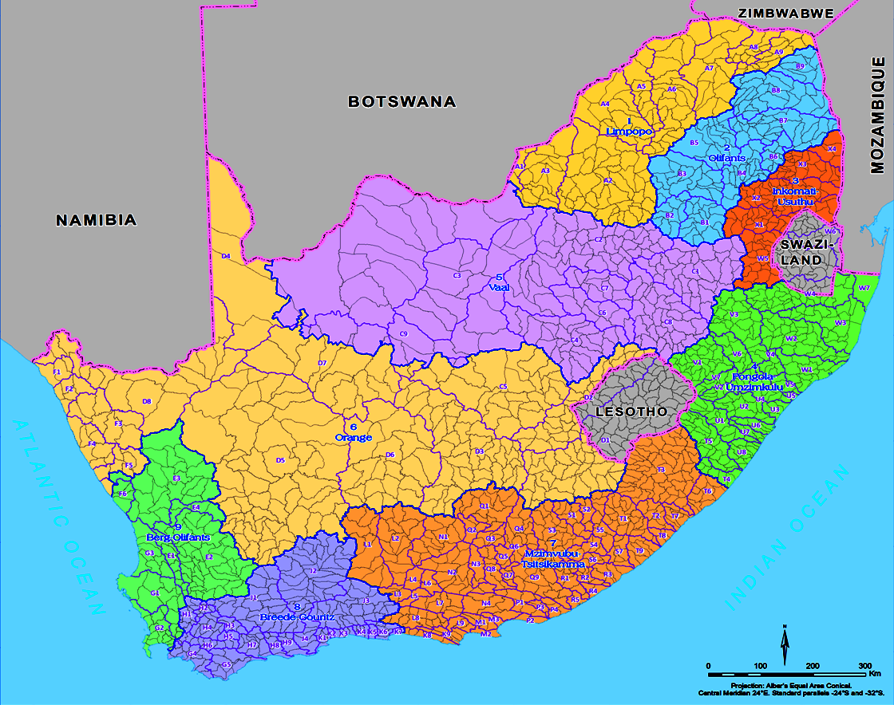
Water Management Areas
Limpopo
Olifants
Inkomati-
Usuthu
Vaal
Orange
Pongola-Mzimkulu
Berg-Olifants
Mzimvubu-Tsitsikamma
Breede-Gouritz

Slide 5
HIGH LEVEL PROJECT PLAN FRAMEWORK
Aug12-July 13
Aug13-July 14
Aug 14-July 15 and beyond
Approach
CMA IMPLEMENTATION PLAN
Preparatory Phase
Establishment Phase
Operation Phase
Sustain & Improve
Gazetting of WMAs
1 Month
Implementation of Initial Functions
Delegation of functions
Project Phases
Cross Cutting Activities
Finalising Business Cases
Approval of Business Cases by NT and listing under PFMA
Office Accommodation
2 Months
Setting up of National Steering Committee
Gazetting of CMAs
Human Resources
8 Months
Setting up of Regional Steering Committees
Appointment of Governing Board
Systems
1 Month
Appointment of dedicated team
Appointment of Chief Executive
Budget secured MTEF
Time Frames
PHASE 1 : Breede-Gouritz, Inkomati-Usuthu and Pongola Mzimkhulu
PHASE 2 : Berg-Olifants-Doorn , Vaal , Olifants and Limpopo
PHASE 3 : Orange, Mzimvubu-Keiskamma
Aug12-July 13
Aug13-July 14
Aug14-July 15 and beyond

Slide 6
PROJECT GOVERNANCE ARRANGEMENTS
PROJECT GOVERNANCE ARRANGEMENTS
Flagship Projects
Business Process Review Committee
Minister
Review pricing & funding strategy
Economic Regulator
NWRS
Legislative Review
IRR
Need for PMO
WSLG
DG
Project Sponsor
DDG Policy & Regulation
National STEERING COMMITTEE
Regional
Steering Committees
Project Champion
CD Institutional Oversight
Inkomati-Usuthu
Breede-Gouritz
Inkomati-Usuthu
Olifants
Mzimvubu to Keiskamma
Olifants
Project Leader
Breede-Gouritz
Limpopo
Vaal
Project Manager & Selected Officials
Pongola-Mzimkhulu
Orange
Berg- Olifants
Project Office

Slide 7
GOVERNANCE
Oversee institutional establishment;
Oversee governance (manage board appointment processes, training etc.);
Oversee shareholder compact;
Oversee business plans, quarterly performance reports and financial statements etc.
Parliament
Minister
DWA
Institutional oversight (national & regional)
Portfolio Committee reviews reports and plans (hearings, visits)
Minister appoints boards; approves shareholder compact
Public institutions report to the public and Parliament through Annual Reports and Annual Financial Statements and to the Department with quarterly performance
reports
TCTA
NWRI
CMA 1
CMA 2
CMA 9
Water board 3
WB
2+1
WRC
WB
3
279 WUAs &Irrigation Boards
7
Notes:
Elaborate on this, add government water schemes

Slide 8
DEVELOPMENT OF STARTERPACK
Support Area | Document | Purpose | Level of effort
Process | Start-up process guide | Overarching guide that describes the start-up processes, the inter-linkages, responsibilities and time frames | M
Governing Board | Board Training Manual | Framework for the Board training including materials | M
 | Board Charter | Outlines Board processes and conduct to ensure good governance | L
 | Shareholder Compact | Effectively provides a service level agreement between the Board and the Minister | L
 | Committee Structure | Outlines the governance committees that are needed, how often they need to meet and how these should be made functional | L
 | Business Plan Template | Guides the structure of the business plan aligned to the governmental planning processes. Some degree of process/protocol are needed (so not just a template) | L
 | Board Performance System | To ensure good governance Board members need to perform, and they need to understand what this entails | M

Slide 9
Organisational | Human Resource Policies | Range of policies that guide recruitment, job evaluation and performance management. | M
 | Procurement system | Clear guidance on procurement, aligned to governmental approaches, is necessary | L
 | CMA Structures and salary scales | Provides a guide of how CMAs, of different natures, could be structured and includes provisional salary scales | M
 | *Remuneration policy for CEOs | DWA needs to provide stronger oversight on this and will develop regulations, therefore, this guide provides the first step to ensure salaries are aligned to governmental scales | L
 | *Draft CEO Contract | Linked to the above, there is a need to set out the roles and responsibilities of the CEO. NT would actually prefer to see this contract. | L
 | Asset and equipment Management | Provides a framework for the management of transferred and new assets and equipment. This is needed early in the establishment process. | M

Slide 10
Financial | Systems requirements and transfer | Provides a framework for the development of systems needed to generate revenue and establish financial controls | M
 | Systems protocols | Guides the exchange of information and data between CMA and DWA | M
Institutional Performance | Quarterly reporting | Provides a reporting framework. Must include financials | L
 | Annual reporting frameworks | Outlines the annual reporting framework. | L
Catchment Management Strategy | Guidelines for the development of a CMS | Outlines the contents of the CMS and needs to provide the actual processes required (current guide does not do this and is dated) | H

Slide 11
PROGRESS OF THE ESTABLISHMENT CATCHMENT MANAGEMENT AGENCIES
Fast track development of business cases
Require to develop Vaal and Orange business cases asap
Eastern Cape RO initiated Mzimvubu Tsitsikamma
Western Cape RO will finalise Berg-Olifants business case
Meeting with National Treasury to list Inkomati Usuthu and Breede Gouritz CMAs
Amendment of the process to appoint governing board in the National Water Act
Finalise the Starterpack
Established 4 task teams Monitoring and information, delegation of functions, HR and Financial arrangements.

Slide 12
[G1]
Water Management Areas | Proposed WMA CMAs | Governing Board Appointed | No of Proto CMA staff | No. of Vacant Proto-CMA Posts | Estimated Full Staff Compliment for new CMA
1. Limpopo | Limpopo | 2013/14 | 62 | 15
2. Crocodile West Marico |  |  | 91 | 53
3. Levhuvu-Letaba | Letaba- Olifants | 2015/16 | 43 | 07
4. Olifants |  |  | 65 | 36
5. Inkomati CMA | Inkomati -Usuthu | 2012/13 | 4 | 0
6. Usuthu |  |  | 3 | 0
6. Mhlatuze | Thukela, Mvoti to Umzimkulu | 2014/15 | 28 | 14
7. Thukela |  |  | 40 | 12
11 . Mvoti to Umzimkulu |  |  | 38 | 18

Slide 13
[G1]
Water Management Areas | Proposed CMAs | Governing Board Appointed | No of Proto CMA staff | No. of Vacant Proto-CMA Posts | Estimated Full Staff Compliment for new CMA
8. Upper Vaal | Vaal | 2014/15 | 96 | 30
9. Middle Vaal |  |  | 9 currently + 16 additional post created | 22
10. Lower Vaal |  |  | (Region is not sure)16 | 19
12. Mzimvubu to Keiskamma | Mzimvubu to Keiskamma & Fish to Tsitsikamma | 2015/16 | 23 (for both WMAs 12 and 15)
15. Fish to Tsitsikamma |  |  | 23 (for both WMAs 12 and 15)
13. Upper Orange | Orange | 2015/16 | 31 | 22
14. Lower Orange |  |  | 18 | 17
16. Gouritz | Breede &Gouritz | 2012/13 | 13 | 10
18. Breede- Overberg CMA |  |  | 0 | 0
17. Olifants-Doorn | Olifants/Doorn & Berg | 2015/16 | 15 | 9
19. Berg |  |  | 12 | 15

Slide 14
NEXT STEPS
2 Business cases will be on route to Minister in June
3 Business cases to be initiated within next two months
Task teams established and developing implementation plan
Regional Coordination to identify which Regions to represent task teams
Regional Steering Committee meetings to inform stakeholders of current plans/processes
Regional communication strategy to include Directorate Communication
Update Risk plan

Slide 15
COMMENTS/QUESTIONS THANK YOU

